Slide 1
Learning Stuff! Building Stuff! Doing Stuff! TOGETHER!
AI for Hams
What It Actually Does — and What You Can Do With It
Jon Pearce WB2MNF
Gloucester County Amateur Radio Club
W2MMD
Serving Our Community & Amateur Radio For 67 Years
Notes:
Welcome. Today: what AI actually is, the tools, and about a dozen real projects we built with it at the clubhouse. Everything I show you actually happened - nothing hypothetical.

Slide 2
The Biggest Obstacle Is Not Technical
It is a failure of imagination
"Most people try AI once, get a decent answer to a simple question,
think that's neat, and stop."
They never discover
Why they stop
Today's goal
• It can write a program for you
• It can teach you a subject
• It can design a system
• It can operate your equipment
• It can work while you sleep
Not because AI failed them.
Because they never thought
to ask for more.
The barrier is knowing what
is possible.
Show enough real examples
that your own imagination
starts filling in the gaps.
Every project here is real.
Nothing is hypothetical.
Gloucester County Amateur Radio Club | AI for Hams
WB2MNF
Notes:
This is the core message. The obstacle is not cost, complexity, or skill. It is not knowing what to ask for.

Slide 3
Don't Know How To Start? Ask AI
The single most useful prompt pattern — and three rules
The setup
What I told him to type
I put a small Estes rocket on the table
in front of a STEM student and asked:
"How high will it fly?"
He froze. No idea where to begin.
"Jon put a rocket in front of me and
asked me how high it would fly.
How do I figure that out?"
Claude walked him through every step.
Three Rules That Would Have Saved Me Weeks
1. Talk to it like a person. Forget it is AI. Give it context the way you would a knowledgeable colleague.
2. Don't know how to start? Ask AI how to start. Ask for a format, an outline, a first draft to react to.
3. Don't know if it can do something? Ask AI. Don't research it. Don't guess. Just ask.
Gloucester County Amateur Radio Club | AI for Hams
WB2MNF
Notes:
The barrier was not knowledge. It was imagination. Ask AI how to ask.

Slide 4
What We'll Cover
One hour, four parts, about a dozen real projects
Part 1 — Foundations
Part 2 — The Tools
What AI actually is
Tokens, context windows, and cost
Cloud models vs. local models
What it does well — and badly
Chat — conversation in a browser
NotebookLM — answers from your docs
Claude Code — AI as operator
Agents — works while you sleep
Part 3 — The Projects
Part 4 — Getting Started
Documents & presentations
Operational assistance
Programming assistance
Large-scale signal analysis
What to try first
What it costs
Where to go from here
Gloucester County Amateur Radio Club | AI for Hams
WB2MNF
Notes:
Roughly 15 minutes per part.

Slide 5
1
Foundations
What AI actually is, and what it costs

Slide 6
What "AI" Actually Means in 2026
Not robots. Not science fiction. A program you talk to.
A large language model is a program trained on an enormous body of text that produces useful output from natural language input.
You type
It responds
That's it
Plain English.
A question, a request,
a description.
Plain English.
Or code, or a document,
or a spreadsheet.
No special syntax.
No commands to memorize.
Just conversation.
It does not "think" the way you do. It predicts what a knowledgeable person would say next. In practice that distinction stops mattering — the output is useful whether or not there is understanding behind it.
Gloucester County Amateur Radio Club | AI for Hams
WB2MNF
Notes:
Do not get hung up on whether it understands. Judge it by output.

Slide 7
Tokens: Why You Should Care
The unit of AI thinking, usage limits, and billing
~750
~400
200K
words per 1,000 tokens
tokens per page of text
token context window (Claude)
1. AI thinking
2. Usage limits
3. The bill
Everything the model reads
and writes consumes tokens.
A 20-page PDF is ~8,000
tokens before it even
starts answering.
Subscriptions cap you by
token consumption.
I hit the Pro limit during a
morning of heavy use and
upgraded to Max out of
sheer impatience.
AI agents making API calls
pay per token.
Mine ran up enough to buy
a basic HF transceiver
before I caught it.
Gloucester County Amateur Radio Club | AI for Hams
WB2MNF
Notes:
The token cost lesson is in the agents section. Watch which model your automation uses.

Slide 8
Cloud Models vs. Local Models
Capability, cost, and what hardware you need
Cloud — runs on their servers
Local — runs on your hardware
Claude, GPT, Grok, Gemini
Hundreds of billions of parameters.
Best capability available.
Subscription or per-token charges.
Needs an internet connection.
Gemma, Qwen, Llama, Mistral
A few billion parameters.
Handles routine work well.
Free after the hardware.
Works with the internet down.
What Local Models Need
Graphics hardware, not RAM. Inference runs on the GPU. My Dell server has 256 GB of RAM and no GPU — a response that takes seconds on a Mac Mini takes minutes on it.
Gamers have the advantage. An RTX 3080/3090/4090 with 12–24 GB of video memory is excellent AI hardware.
Apple Silicon is the exception. M-series Macs share memory between CPU and GPU — a Mac Mini runs 27B models at conversational speed.
Gloucester County Amateur Radio Club | AI for Hams
WB2MNF
Notes:
I bought a Mac Mini M4 Pro 48GB specifically to run local models for free.

Slide 9
What It Does Well — and Where It Fails
Both halves matter
Genuinely good at
Genuinely bad at
• Writing and editing — articles, reports, plans
• Generating code you never have to read
• Teaching any subject at any level
• Translating structured data between formats
• System administration over SSH
• Reviewing your work for consistency
• Reading schematics and describing circuits
• Being a patient, tireless collaborator
• Guaranteed factual accuracy
Verify frequencies, specs, regulations
• Real-time data without a search tool
• Reading your SWR meter or S-meter
• Visual layout and spatial arrangement
• Knowing when it is wrong
Hallucination is real. Checking is not optional.
Gloucester County Amateur Radio Club | AI for Hams
WB2MNF
Notes:
Hallucination example: it told Chris a #14 wire would not fit through a toroid. It was wrong, and admitted it when challenged.

Slide 10
2
The Tools
Four ways to work with AI

Slide 11
Five Ways to Work With AI
Each one fits a different kind of job
Chat
NotebookLM
Cowork
Claude Code
Agents
claude.ai in a
browser
Learning, writing,
planning,
brainstorming.
Where you start.
Where most work
happens.
Answers only from
documents you
upload.
No hallucination.
Every answer
cited.
Manuals, archives,
recordings.
Desktop app
Multi-step work
across several
files at once.
Reads, edits, and
checks its own
output.
Documents & decks.
Runs in a terminal
SSH access to your
machines.
Does not tell you
what to type —
it types it.
The game changer.
OpenClaw,
Hermes
Your hardware,
on a schedule.
Works while
you sleep.
Recurring jobs.
Gloucester County Amateur Radio Club | AI for Hams
WB2MNF
Notes:
Most hams should start with chat and stay there until a need pushes them further.

Slide 12
AI Will Teach You Anything
The WSJT seminar came entirely out of one conversation
How the conversation went
Then produce the deliverable
1. "Give me a briefing on each WSJT mode"
2. Follow-up questions on what interested me
3. "What is Reed-Solomon encoding?"
— explain every term I don't know
4. "What are WSPR's four tone frequencies?"
— give me the actual numbers
5. "How does WSPR reach −28 dB?"
— explain the concept, not just the value
6. "What is the frequency difference between
middle C and the C above it?"
— anchor it to something I already know
Claude built the 20-slide deck
from the same conversation that
taught me the material.
Learning and deliverable, one session.
And stand by during the talk
If an audience member asks
something you can't answer,
Claude is right there.
You don't need to know everything.
Gloucester County Amateur Radio Club | AI for Hams
WB2MNF
Notes:
This is how the March Tech Saturday on WSJT was built. I knew almost nothing about FT8 or Q65 going in.

Slide 13
NotebookLM: Answers From Your Docs
When the answer must come from specific sources, not the whole internet
Why it is different
What it accepts
It only knows what you upload.
It will not guess or fill gaps.
Every answer cites its source —
page, paragraph, or timestamp.
PDFs, web pages, Google Docs,
YouTube videos, audio recordings.
Dozens of sources per notebook.
Equipment manuals
Club history
Meeting minutes
Load your radio manuals.
Load two at once and ask
how to set up WSJT-X on
an FT-991A — it pulls from
both and cites each.
Every issue of CrossTalk
in one notebook.
"When did we first discuss
satellite operations?"
Answered, with citations.
Upload the audio recording
of a meeting.
Get a transcript and a
draft set of minutes.
Gloucester County Amateur Radio Club | AI for Hams
WB2MNF
Notes:
Best tool available when working from a fixed, limited set of sources. https://notebook.google.com/?_gl=1*ksqz19*_ga*MTgyNTU0MDY2OC4xNzM1MTY2NTA4*_ga_W0LDH41ZCB*czE3NTI2MTUyMzkkbzM4JGcwJHQxNzUyNjE1MjM5JGo2MCRsMCRoMA..

Slide 14
Claude Code: The Lightning Bolt
It does not tell you what to type. It types it.
Once Code has SSH access to a machine, it can do anything on it that you could do sitting at the keyboard.
The old way
With Code
AI gives you instructions.
You type them. You read the error.
You paste it back. It gives you more.
Repeat until it works — or you give up.
You describe what you want.
It logs in, runs commands, reads errors,
researches fixes, changes approach,
and keeps going until it is done.
Want ADS-B on a Pi? Gpredict? A weather receiver? Just ask Code.
I have found articles describing Pi projects, pasted the link into Code, and told it to read the article and make my Pi do what it says. It did.
Gloucester County Amateur Radio Club | AI for Hams
WB2MNF
Notes:
This realization saved me hours immediately. I wish I had understood it sooner.

Slide 15
Agents: AI That Works While You Sleep
Persistent, scheduled, unattended
Chat
Claude Code
An agent
Like a phone call.
You dial in, talk,
hang up. Nothing
persists.
Like a contractor
for the day. Point it
at a job, it finishes,
it leaves.
Like an employee.
Job description,
schedule, shows up
whether you do or not.
What Mine Actually Does
Every three hours, six times a day, seven days a week:
• Pulls solar and geomagnetic data from NOAA Space Weather Prediction Center
• Pulls actual WSPR spots received worldwide from WSPRnet
• Has a language model interpret both as a band-conditions observatory report
• Publishes it to the club website automatically
I set it up, tested it, and have not touched it since.
Gloucester County Amateur Radio Club | AI for Hams
WB2MNF
Notes:
Only build an agent when you find yourself doing the same AI task on a schedule.

Slide 16
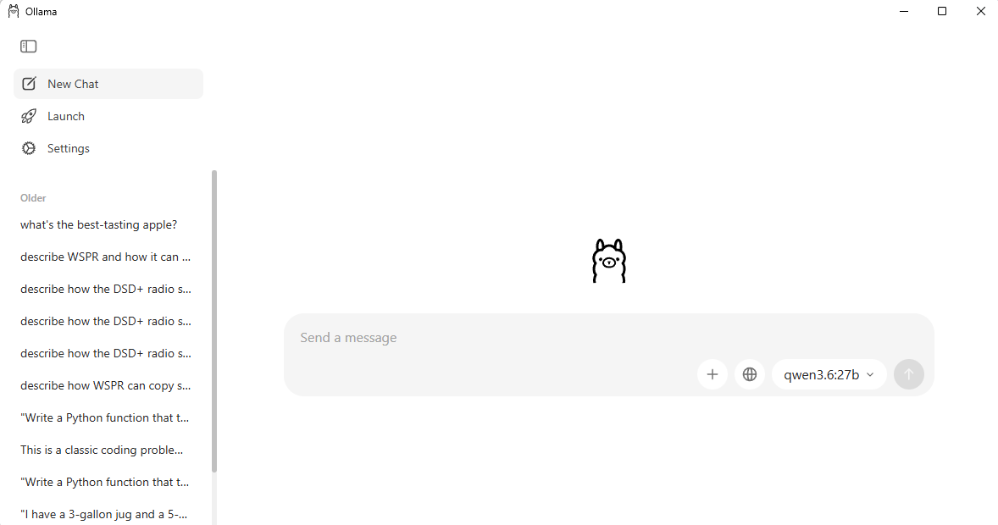
Local Models
Run on local computers (Mac Mini)
May run on other Mac hardware (shared memory)
May run on PC graphics card
Key: Graphics card, not CPU
“Ollama” – connects the models to your computer
  Fetches the model: “ollama pull qwen3.8:27b”
  Provides user query interface
  Allows agent machine to connect to model

Slide 17
Local AI
What Runs Where
Matching AI models to the hardware you actually own
Datacenter
Mac desktop
Gaming PC
Small device
Notes:
Everything here comes from models I actually ran on my own hardware, not from vendor spec sheets.

Slide 18
One Thing Decides Everything: Memory
A model is one big file of numbers — all of it has to fit in memory at once
Too big for memory, and it spills to slow storage and grinds to a halt
Size is measured in parameters — billions of them, written as "B"
Memory decides what you can run. Memory speed decides how fast it runs.
8B
≈ 5 GB
phone / Pi class
30B
≈ 18 GB
desktop class
Rule of thumb
70B
≈ 43 GB
At normal compression, the number of billions is roughly the number of gigabytes of memory you need.
beyond most desks
Notes:
The single number that governs everything is memory. Parameters in, gigabytes out.

Slide 19
1
Datacenter
Racks of specialized processors · $100,000 to millions
This is where the famous names live — the models behind the big chat services
Not a bigger version of a desktop: a fundamentally different class of machine
Two recent releases I looked at needed roughly 650 GB and 320 GB — neither is a home option
You rent access to these. You do not own them.
MODEL SIZE
200 billion – 2.4 trillion
MEMORY NEEDED
200 GB – 1 TB and up
HARDWARE
8+ enterprise GPUs
Newer designs use only a fraction of themselves per word — but the whole model still has to be in memory. Sparse design does not shrink the memory bill.
Takeaway: the best quality available, but always on somebody else's hardware.
Notes:
Frontier models. Impressive, but the hardware is out of reach for anyone outside a data center.

Slide 20
2
Apple Silicon Desktop
Mac Mini or Studio, 32–128 GB unified memory · $1,400 – $4,000
Apple's design lets the AI use the whole memory pool — no separate graphics card
Fast enough to feel instant; quicker than most people read
The ceiling is real: a 70-billion model loaded, then crashed mid-answer
Another needed 65 GB and simply refused to start
68
SWEET SPOT
25 – 35 billion
MY MACHINE
M4 Pro, 48 GB
words per second
CEILING
my Mac Mini, 21 GB model
~35 billion
The same class of model on a 12 GB graphics card managed 2.9 words per second.
Takeaway: the practical high-water mark for a home or club setup.
Notes:
This is the tier I settled on. Fast, private, and no monthly bill.

Slide 21
3
Gaming PC with a Graphics Card
Windows desktop with an NVIDIA card · $800 – $3,000
Limited by memory on the card, not system memory — a much smaller pool
12 GB card fits about 9 billion · 16 GB fits 14 · 24 GB fits 30
Exceed the card and work shifts to the main processor
The drop-off is a cliff, not a slope
Same size model. Same afternoon. 16 minutes for one answer on the graphics card.
Takeaway: excellent inside the card's limit, nearly unusable past it.
Notes:
This is the most important practical lesson: the graphics card memory limit is a hard wall.

Slide 22
4
Small Devices
Raspberry Pi, phones, embedded boards · $50 – $500
MODEL SIZE
BUILT FOR
200 million – 4 billion
One narrow job
Often under 2 GB on disk
Sort this, extract that, trigger the next step
REALITY CHECK
PROVEN ON
No broad knowledge
Raspberry Pi 5
Expect confident wrong answers outside its lane
A 2.6 billion model runs there with tool support
Takeaway: think appliance, not assistant.
Notes:
Useful, but only for narrow well-defined jobs. Not something you hold a conversation with.

Slide 23
Side by Side
Tier | Memory | Model size | Speed | Cost
Datacenter | 200 GB – 1 TB+ | 200B – 2.4T | Fast | $100k +
Mac desktop | 32 – 128 GB | 25 – 35B | 50 – 70 wps | $1.4k – 4k
Gaming PC | 12 – 24 GB on card | 8 – 30B | 30 – 60 wps | $800 – 3k
Small device | 2 – 8 GB | 0.2 – 4B | 20 – 40 wps | $50 – 500
wps = words per second, roughly. The highlighted row is my Mac Mini.
Notice the speeds barely differ across three of the four tiers. What changes is how capable the model can be — not how quickly it answers.
Notes:
The counterintuitive part: speed is comparable across tiers. Capability is what scales.

Slide 24
Two Things That Surprised Me
1
Bigger is not automatically better
2
Design beats raw size
A 32-billion model scored worse than a 30-billion one — and ran five times slower
A 30-billion model invented a co-inventor of WSPR who does not exist
Published benchmarks measure programming tasks, not whether it knows your hobby
Newer models load fully but use only a slice of themselves for each word
Mine has 35 billion parameters but behaves like a 3-billion one for speed
Same memory footprint, about five times the speed of an older design
Test any model on something you know well. That is where the invented facts show up.
Notes:
The WSPR question was my test. It is obscure enough that a model either knows it or makes something up — and several made something up very convincingly.

Slide 25
How to Choose
1
Start with the hardware you already own
It eliminates most of the field immediately
My setup
Mac Mini
2
Match the model to the job
35B model, always on
Not to whatever tops the leaderboard this month
Gaming PC
3
Test it on something you know well
8B model, quick jobs
Obscure, specific, and verifiable by you
Raspberry Pi
Run a small one and a large one
runs the schedule
4
Routine work on the small model, judgment on the large
Notes:
Closing point: you do not have to pick one. Small model for routine work, large model for judgment.

Slide 26
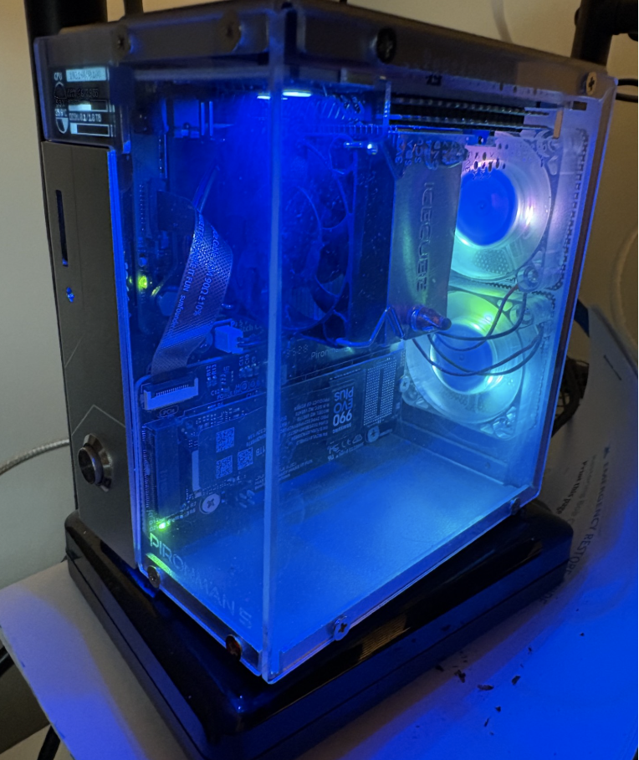
“Bob” – OpenClaw Agent Computer
Raspberry Pi 5
Pironman case
M.2 Drive
2 tb backup drive
Runs qwen3.6:35b-a3b-nvfp4 on the Mac mini
Minor tasks from qwen3:8b on the Workstation
Does routine tasks that don’t require significant thinking or accuracy
  Mail checking
  New YouTube videos
  Saturday weather
  STEM satellite passes

Slide 27
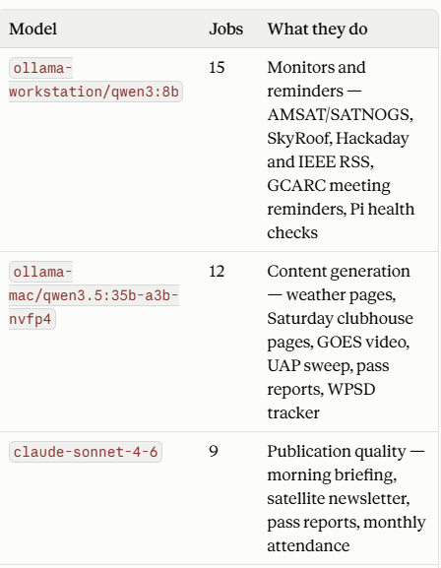
“Arnold” OpenClaw Computer
Dell workstation reclaimed from SQL
256 gb RAM
SAS and SATA drives
Runs Claude Sonnet
Runs GCARC Skunkworks updates that require accuracy

Slide 28
The Mistake That Cost Me an HF Radio
Know which model your automation is using
What I did wrong
How I found out
Configured my agent to send every
task to Claude's paid API.
Every task. Including routine ones a
free local model handles fine.
Each call cost pennies. It added up.
I asked Claude to analyze the agent's
own log files and produce a cost
breakdown by job type.
The report was clear and damning.
AI diagnosed its own overspending.
The Fix — and the Rule
Route routine scheduled work to a free local model. Reserve the paid API for tasks that genuinely need the capability. Cost dropped immediately.
Always know which model each task uses. Use the cheapest one that produces acceptable output. And monitor your usage — if you can't see it, build a dashboard. Claude will write you one.
Gloucester County Amateur Radio Club | AI for Hams
WB2MNF
Notes:
This is the single most expensive mistake I made and the easiest to avoid.

Slide 29
3
The Projects
What we actually built at W2MMD

Slide 30
Writing for the Club
The most ordinary use — and the most common
CrossTalk articles
EmComm plans
Lightning protection
The EFHW antenna piece went
through three rounds of
tightening in four minutes:
remove internal references,
fix terminology, sharpen
the theme.
Multi-document capability
plans developed over long
sessions.
Claude served as drafter
and devil's advocate —
pushing back on assumptions.
I described the cables and
connectors in plain text and
uploaded NR2B's guide as a PDF
so it used correct terminology.
Claude decided on its own to
draw the wall diagram.
The pattern is always the same: describe what you need, let AI produce a first draft, then iterate.
The skill is not in the writing — AI handles that. The skill is knowing what to ask for and recognizing when the result is right.
Gloucester County Amateur Radio Club | AI for Hams
WB2MNF
Notes:
Nearly every piece of written content Skunkworks produced in 2026 came out of AI conversation.

Slide 31
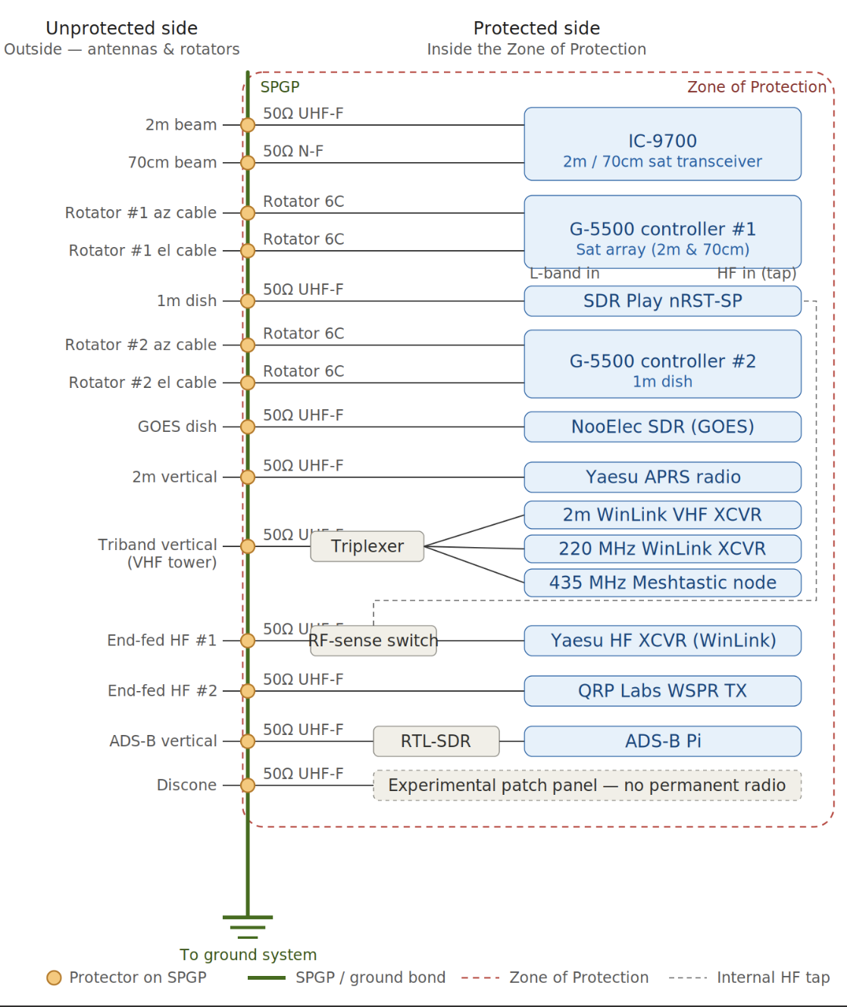
Satellite Station Cable Diagram
Described the devices and cables in text
Pasted in a copy of Ron’s book
Asked for SVG diagram

Slide 32
When AI Gets It Wrong — and Fixes Itself
Chris AD2CS's 49:1 matching transformer
Claude's job was note-taking
It volunteered an opinion
The design was Chris's.
I brought Claude in to track the
conversation, look up component
costs, and draft the announcement.
"Twenty-one turns of #14 will not fit
through the 1.4-inch center hole."
Chris had wound toroids before.
He knew it would fit.
I asked Claude to defend its position. It did the actual math — and reversed itself completely. #14 fits with room to spare.
Lesson one
Lesson two
Human expertise is the check that
catches confident wrong answers.
"Go back and check whether that is
actually true" is a powerful prompt.
Gloucester County Amateur Radio Club | AI for Hams
WB2MNF
Notes:
If I had been designing this myself with less experience, that error would have gone in unchallenged.

Slide 33
Building Software You Cannot Write
The club event registration system
I cannot write HTML. I do not understand JavaScript. The system has been in production for months.
862
3
0
CSV
lines of code
database collections
lines I wrote
reporting & export
How it was built
What it enabled
Feature by feature, in conversation.
"I need a sign-in screen." It wrote one.
"Add an organizer login." It added it.
"Reports filtered by date." Done.
Grok also taught me to set up the database.
Every sign-in is now data.
Which members attend regularly.
Which activities draw participation.
Who stopped showing up — and when.
Gloucester County Amateur Radio Club | AI for Hams
WB2MNF
Notes:
This is the participation data the board now uses to understand member engagement.

Slide 34
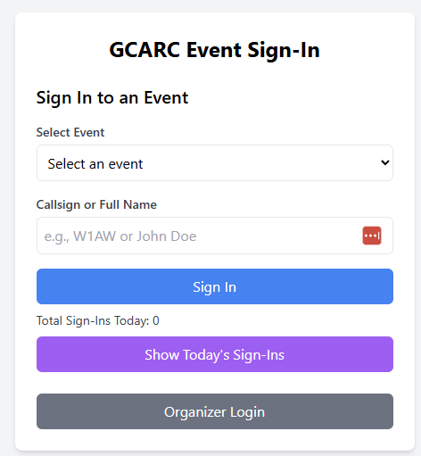
Slide: Architecture at a Glance
Frontend: Single index.html + compiled Tailwind styles.css
Client logic: Vanilla JavaScript (Firebase modular SDK v10)
Hosting: Firebase Hosting (static files in public/)
Database: Cloud Firestore (members, events, sign_ins)
Auth: Firebase Authentication (email/password for organizers only)
Local tools: Node.js scripts for roster import/export/cleanup

Slide 35
Automating the Monthly Meeting Deck
Twelve times a year, handed off entirely — now done in Cowork
Three inputs
Plus a runbook
What I do now
1. Last month's deck
2. This month's CrossTalk
(60-page PDF)
3. Tony K3TS's contest
picks email
Written once. Describes
slide by slide what changes
each month and where the
information comes from.
Standing instructions.
Supply the files.
Answer one question.
Look at the result.
That is the whole job.
It Caught Its Own Mistake
After editing, it rendered every changed slide to an image and looked at them.
Tony's June contest text was longer than usual and overflowed the bottom of the slide. Claude reduced the font, tightened the spacing, re-rendered, and confirmed the fix.
It also found the slides had drifted out of the positions the runbook specified — so it located each target slide by reading its content instead of trusting the numbers.
Gloucester County Amateur Radio Club | AI for Hams
WB2MNF
Notes:
Any recurring document pulling from multiple sources is a candidate for this.

Slide 36
Building the Ham Space Camp Curriculum
Five weeks, ten sessions, fourteen deliverables
67
46
14
6
page Student Workbook
page Instructor Guide
total deliverables
sessions, fully scripted
The Turning Point: Reading the Whole Package at Once
When the draft was complete, I had Claude review every session end to end. The problems were problems of order, not content. Modulation modes introduced piecemeal across sessions were consolidated into one. An analogy buried in a technical aside was moved earlier, where it actually taught something. Definitions that had drifted apart between session one and session five were reconciled.
Rebuild, don't patch
Stay the editor
A dozen small in-place edits leave a
document subtly incoherent.
It gave wrong calculator keystrokes.
I caught it because I checked.
Gloucester County Amateur Radio Club | AI for Hams
WB2MNF
Notes:
Camp starts July 6 with seven students. None of this is visible when you edit one screen at a time.

Slide 37
One AI Training Another
The FCC Technician license tutor
The hard requirement
Grok failed it
Claude did it
When a student answers wrong,
explain why that answer is wrong —
without revealing the right one.
The learning is in the struggle.
"No, A is wrong.
The correct answer is C."
Every single time.
No reprompting fixed it.
First try. Never violated
the rule across hundreds
of questions.
But it needs a subscription.
So I Asked Code to Train a Free Model
Code built automated test scripts that simulated students answering right and wrong, detecting five specific failure types. It ran the free model through them hundreds of times, analyzed each failure, wrote a more specific instruction, and re-tested. A dozen versions went through that loop.
The biggest wins were not prompt changes at all — they were bugs in the surrounding software Code found and fixed. Retrieval failures dropped from 50% to zero. Response time went from nearly two minutes to under 25 seconds.
Final verdict, honestly delivered: this free model is not capable enough. Wait for a better one.
Gloucester County Amateur Radio Club | AI for Hams
WB2MNF
Notes:
More patience and rigor than any human trainer could sustain — and an honest capability assessment at the end.

Slide 38
Translating Between Two Radios
DMR codeplugs, AnyTone to Retevis
Step 1 — Export source
Step 2 — Sample target
Step 3 — Translate
Export your working codeplug
from the old radio's
programming software to CSV.
200,000 contacts.
365 channels.
Enter one or two channels by
hand in the NEW radio's
software. Export that.
This is the Rosetta Stone —
it shows AI the exact format.
Give AI both files.
It maps every field, converts
every value, and produces a
CSV the new radio will
actually import.
Same Trick, Different Source
CrossTalk publishes a table of club members' DMR IDs every month. I pasted a screenshot of that table into Grok and asked for an importable contact list. It read the image, extracted every callsign and ID, and produced the CSV. Fifty-plus contacts, no typing, no transcription errors.
Any structured data that exists in one format and needs to exist in another is AI territory.
Gloucester County Amateur Radio Club | AI for Hams
WB2MNF
Notes:
Works for any two radios where you have the programming software.

Slide 39
The WSPR Network
Eighteen beacons, built and deployed by a club
The problem
What Code built
Eighteen members. Pi experience ranging
from expert to "what is a Pi?"
Configuring each one by hand at the
build session would have consumed
the entire day.
A turn-key SD card image.
Insert card. Apply power. The Pi makes
its own WiFi hotspot, your phone pops
up a setup page, and it shows you the
IP address and a QR code before it
switches to your home network.
Burning the cards
Testing
And it still wasn't perfect
Code worked through the
registration list, prompting
me to swap cards one by one,
patching each member's
callsign and band in
automatically.
Every device tested with an
antenna at the clubhouse.
All but one produced spots
from distant stations — and
that was a dead-band day.
One member could not get
their beacon onto their home
WiFi despite all of it.
That is the reality of club
technology deployment.
Gloucester County Amateur Radio Club | AI for Hams
WB2MNF
Notes:
The propagation report agent covered earlier publishes results from this network six times a day.

Slide 40
Three Programming Jobs I Never Had to Learn
Describe the behavior, not the implementation
IC-9700 automation
Node-RED rotator
Agent installation
SatNOGS needs both bands
passed through to the SDR.
That requires the second VFO
active.
Code wrote a program that
sends CI-V commands over USB
from a spare Pi, and set it to
run hourly.
I have never typed a CI-V
command in my life.
The dish rotator was broken.
I spent hours clicking through
the visual editor and could
not find the bugs.
Code read the program as text,
compared it against the working
rotator, and found 47
differences — reversed relay
commands, wrong elevation
range, bad conversion math.
Fixed remotely over VPN.
The first install was done
through chat — paste a
command, read the error,
paste it back, repeat.
The second was done by Code
over SSH. No copying, no
pasting, no typing.
When I later needed Hermes
installed on the Mac Mini,
I just told Code to do it.
It handled the errors itself.
Gloucester County Amateur Radio Club | AI for Hams
WB2MNF
Notes:
A Node-RED node that sends move looks identical to one that sends stop. Code does not need to click each one.

Slide 41
Programming Mesh Nodes With AI
A use that is not obvious until you try it
Meshtastic and MeshCore nodes are configured from a command line. Claude Code can drive that command line — which means it can program your nodes for you.
What you say
What Code does
Why that matters
"Set the tower node to
LONG_FAST, 915 MHz,
30 dBm, and turn off
power saving."
Issues each command,
reads back every value,
and tells you if the radio
accepted something
different from what you
asked for.
The firmware silently
clamps values.
I set a 900-second
interval. It read back
as 1800. No error.
The Real Win: A Node You Cannot Reach
The clubhouse tower node sits 89 feet up. Nobody is climbing it to change a setting. Code configured remote administration before the node went up, then verified it end to end by reading the transmit power back from the ground.
Gloucester County Amateur Radio Club | AI for Hams
WB2MNF
Notes:
Read-back is the whole point. Every mesh failure I hit looked like success. Code checks every value it sets.

Slide 42
SDR Meets AI
Signal analysis without being a DSP engineer
What you can ask for
How it works
• Identify an unknown signal from a capture
• Measure your own station's performance
• Validate weak-signal decodes
• Plot an antenna pattern from field data
• Compute and correct Doppler
• Hunt down a source of interference
You capture IQ data with your SDR.
Code writes the analysis programs,
runs them, reads the output, adjusts
the approach, and explains what the
numbers mean.
In Progress: The Clubhouse Noise Survey
An SDR on a rotatable directional antenna sweeps 360 degrees, capturing a slice of spectrum at every heading and logging the noise power. The result is a map of where interference is coming from — the fairgrounds pumps, the power lines, the cell towers, or our own transmitters. A portable version with GPS is being built for surveying members' home stations.
Gloucester County Amateur Radio Club | AI for Hams
WB2MNF
Notes:
The survey coordinates with SatNOGS so it pauses during satellite passes.

Slide 43
Decoding the ISS: When the Answer Is No
The most technically involved project — and it failed usefully
The capture
First: prove it is real
May 27, 2026. Near-zenith ISS pass,
86.5 degrees, 418 km at closest approach.
6.2 gigabytes of raw IQ data
over nine minutes.
Before trying to decode anything, Code
correlated signal power against ISS
elevation and distance.
It tracked. The signal was genuinely
from the ISS.
Three independent decoders. Hundreds of parameter combinations. Every symbol rate, every code rate, every tuning offset. Zero locks. Every output file was empty.
The diagnostic that closed it
The actionable conclusion
A constellation plot showed pure noise —
no symbol structure at all to lock onto.
We are 6–10 dB short. It is an antenna
problem, not a software problem.
Gloucester County Amateur Radio Club | AI for Hams
WB2MNF
Notes:
One evening of work replaced what could have been weeks of chasing a software problem that did not exist.

Slide 44
W2MMD RF Environment Survey System
Automatically rotates directional antenna through 360° azimuth (and optional elevation), capturing RF signals at each heading using an RTL-SDR receiver
Identifies signal frequency, strength, bearing, and bandwidth across VHF and UHF bands simultaneously in a single sweep
Cross-references detected signals against the FCC license database and OpenStreetMap infrastructure features to identify noise sources
Overlays bearing lines on an interactive map — color-coded by frequency band, weighted by signal strength
Runs automated sweeps multiple times daily, building a time-series picture of how the RF environment changes by time of day and day of week
Flags new, changed, or unidentified signals automatically and generates plain-English reports using AI analysis via the club's OpenClaw infrastructure
Portable version runs self-contained on a Raspberry Pi with GPS location tagging — two stations can triangulate noise sources to a specific geographic location
Delivers daily and weekly digest reports by email and to the club Google Drive

Slide 45
The EmComm Situation Recorder
A Pi that logs an emergency net — and where the hard part actually was
What it does
Deliberately narrow AI
Listens to voice traffic on multiple
channels, decodes APRS positions, and
keeps a tamper-evident log.
Ask it on a touchscreen: "where is
WB2MNF", "who is overdue".
Speech to text. Voice detection.
Text to speech. That is all.
Every answer is a database lookup,
read back. No generative step in
the evidence path.
The surprise: the AI was the easy half. Almost every real failure lived in the analog and RF layer — and all of them were silent.
Audio a few dB hot
A 4 ms PTT click
89% vs 50%
Fused two operators’
callsigns into one.
No error anywhere.
Swung the measured
level by 14 dB on
release.
Callsign accuracy at the
right level vs. the level
we were recommending.
Gloucester County Amateur Radio Club | AI for Hams
WB2MNF
Notes:
The "correct" audio level came from studio convention and was simply wrong for this radio and this speech model. Measuring against real traffic found it.

Slide 46
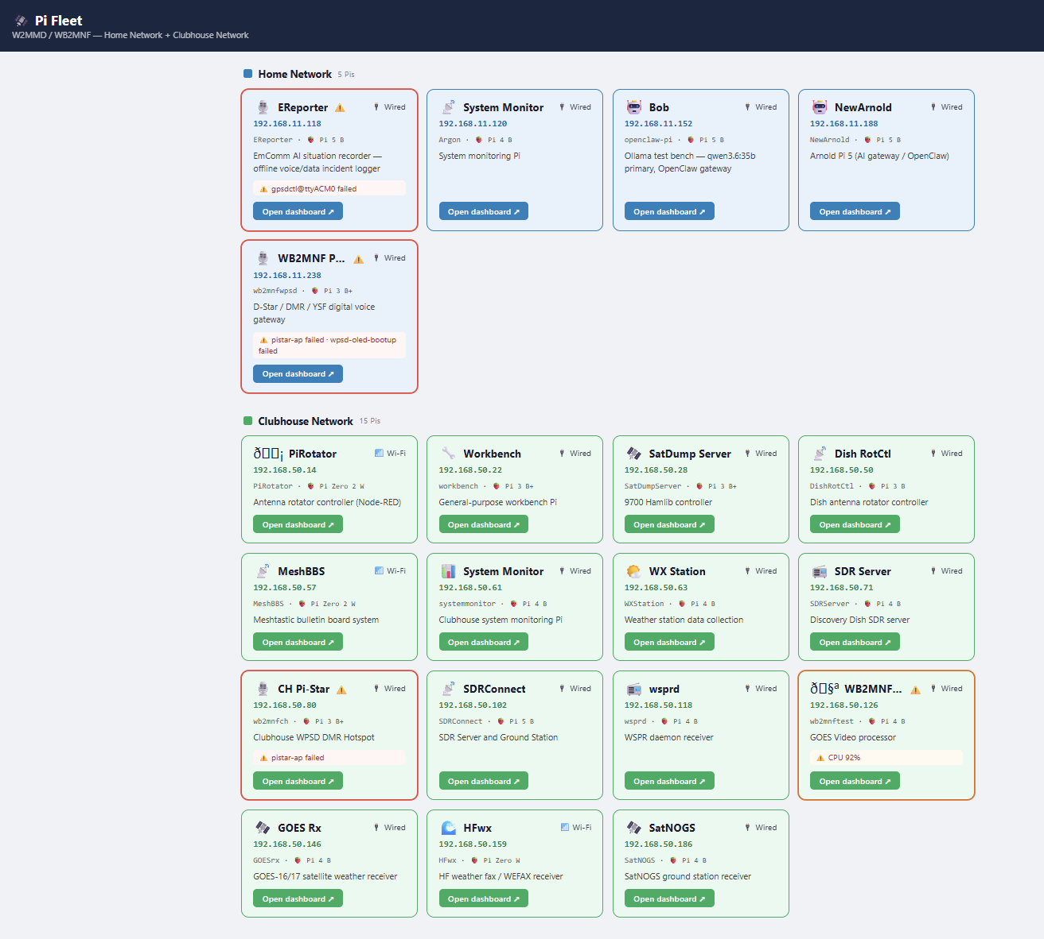
“Pi Fleet” Dashboards
Creates individual dashboards for each Pi
Searches for other Pi’s
Indicates issues
Allows opening each Pi’s dashboard

Slide 47
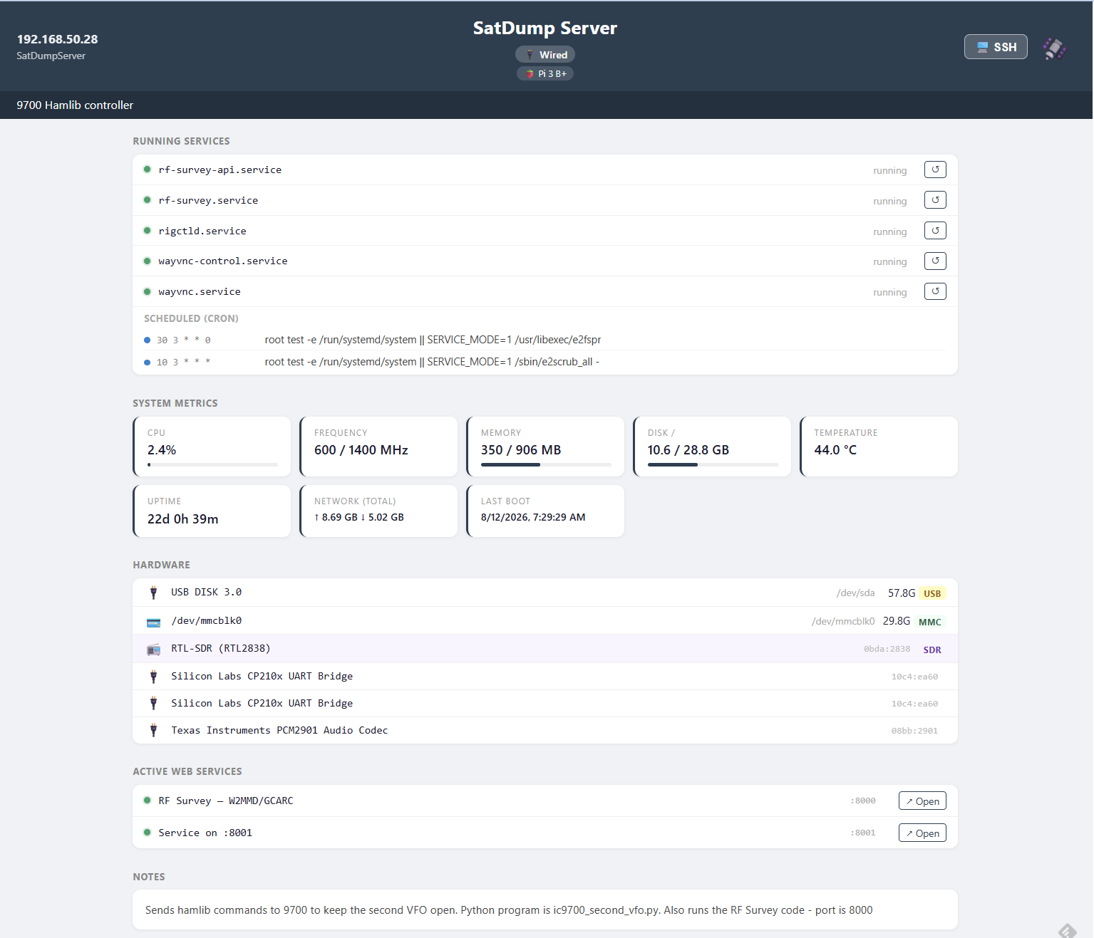

Slide 48
Designing Enclosures With AI
Two prints, two different lessons — both on the table tonight
Heltec LoRa holder
Situation recorder case
Completely designed by Claude.
Two rounds — the first was too thin.
Claude generated the model file
directly.
I know Fusion 360, but use it
rarely enough that every project
means relearning it.
Pi 5 with a five-inch touchscreen,
ports still reachable.
Claude identified which Pi was on the
bench by reading the machine’s own
startup log — the Pi 4 and Pi 5 have
different port positions.
Then it told me not to print it yet.
Saying Which Numbers Are Guesses
The Pi dimensions were exact. But "800×480 HDMI screen" is sold in three physical sizes with different mounting patterns — so three measurements were flagged in the file as guesses, with an instruction not to print until they were checked.
"Don’t start a four-hour print until you’ve measured three things" is a more useful output than a confident file that produces scrap.
Gloucester County Amateur Radio Club | AI for Hams
WB2MNF
Notes:
Pass the actual printed parts around here. Also mention: port openings are full-width slots, not shaped holes — forgiving of a 2 mm error and sidesteps the Pi 4 vs Pi 5 port ordering entirely.

Slide 49
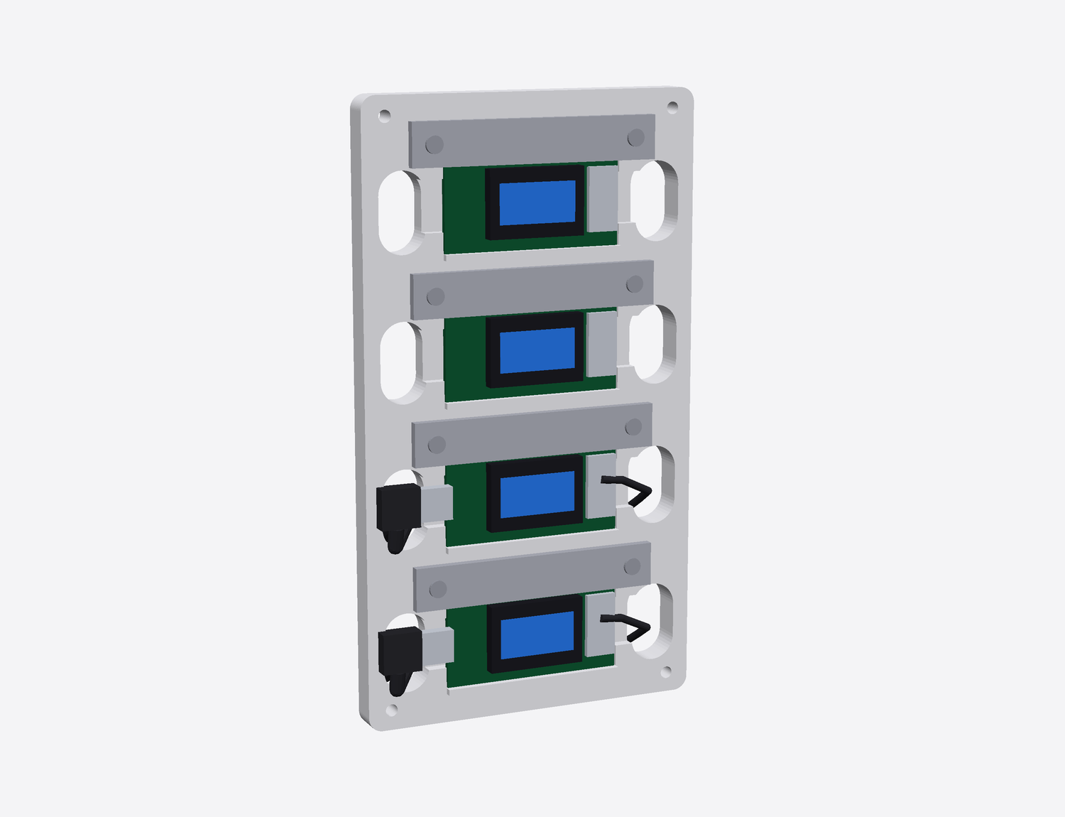
3D Printed Heltec LoRa Holder
Completely designed by Claude
Two rounds (first was too thin)
Claude created the STL
Prusa sliced and printed

Slide 50
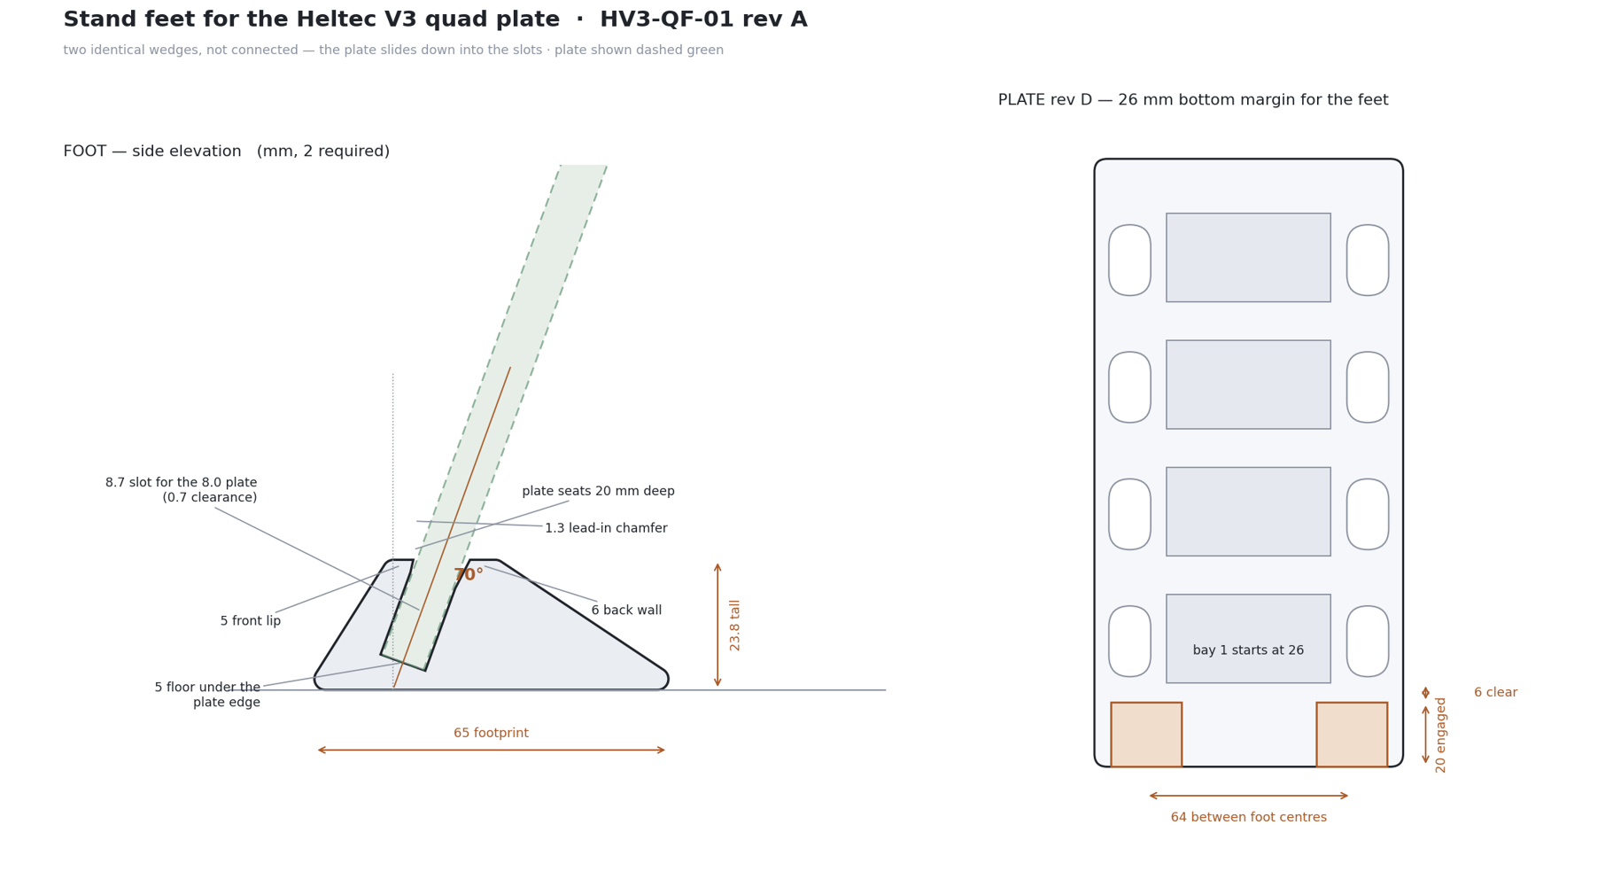

Slide 51
4
Getting Started
What to do Monday morning

Slide 52
What It Costs
Four price points, depending on how far you go
Free
$20 / month
Higher tiers
Hardware
Most services have a
free tier.
Enough to learn what
AI can do and decide
whether it is worth
paying for.
Start here.
Claude Pro or
equivalent.
Chat plus Claude Code.
Enough for almost
everyone. You will hit
the limit on a heavy
day.
For sustained heavy
use.
I upgraded out of
impatience after
hitting the Pro limit
mid-project too many
times.
A Mac Mini or a PC
with a good graphics
card runs free local
models.
Capital cost once,
then zero per query.
Compare that to what you have spent on antennas, radios, or a single hamfest weekend.
Gloucester County Amateur Radio Club | AI for Hams
WB2MNF
Notes:
Twenty dollars a month replaces hours of work per week.

Slide 53
What To Try First
Pick one and do it this week
If you write anything
If you want to learn
If you have a Pi
Draft your next CrossTalk
article, club email, or
meeting announcement.
Then ask it to review the
draft for clarity and length.
Pick a mode or technology
you have never understood.
Ask for a briefing, then
ask questions until you
run out of them.
Install Claude Code and
give it SSH access.
Then ask it to install
something you have been
meaning to try.
If you have manuals
If you have data
If you are stuck
Put your radio manuals into
a NotebookLM notebook and
ask it operating questions.
Faster than searching a
200-page PDF, and it cites
the page.
Any conversion between two
formats — codeplugs, logs,
contact lists, spreadsheets.
Show it the source, show it
the target, ask it to
translate.
Describe the problem and
ask how to approach it.
You do not need a good
question. You need a
starting point you can
react to.
Gloucester County Amateur Radio Club | AI for Hams
WB2MNF
Notes:
Encourage people to pick one thing before they leave today.

Slide 54
The Whole Talk in Three Lines
Knowledge of how to do things on a computer is becoming irrelevant.
What matters is seeing that a thing can be done — and asking.
The limit is not the technology. It is your imagination.
Gloucester County Amateur Radio Club | AI for Hams
WB2MNF
Notes:
Close here, then open for questions.

Slide 55
Resources & Questions
Everything shown today is documented
The tools
Our projects
claude.ai — chat and Claude Code
notebooklm.google.com — source-grounded
chatgpt.com — OpenAI
grok.com — xAI
ollama.com — run models locally
skunkworks.w2mmd.org
articles, satellite passes, license trainer
wp.w2mmd.org
WSPR network dashboard
w2mmd.org
club site and CrossTalk archive
A full write-up of every project in this talk — with the details, the failures, and what I would do differently — is being assembled into a guide for club members.
Questions?
Gloucester County Amateur Radio Club | AI for Hams
WB2MNF
Notes:
Open the floor. Offer to help anyone get started at a Saturday session.

